Slide 1
Social Media Based on metaverse
Author: Ing. Josue Ernesto Galindo Morales.
Professor: Dr. Omar Ali Sataraín.

Slide 2
CR’s description
CR1: The client wishes to include the following marketing strategies in the system:
User percentage time on seeing advertisements.
The typo of content of the advertising attracting the attention of the social media user.
Purchases made through the platform according to female and male products, age, and sexual orientation.
CR2: The type of content of the advertising attracting the attention of the social media user.

Slide 3
CR’s description
CR3:Purchases made through the platform according to female and male products, age, and sexual orientation.
CR4: The system should report statistics of user’s regarding time spent, log-in hours, and activities performed. The reports must be encrypted, and the time span of the report must be flexible.

Slide 4
Initial state of project
Social Media App Based On Metaverse.

Slide 5
Configuration items
In this analysis we considered two main parts for our communication system: Frontend and Backend. Which are important and not particularly the only one, but in essence, the ones that defines the system itself.
Frontend:
GUI’s design.
Multiplatform support for multiple devices: Web, iOS and Android.
2D and 3D realms.
Testing.
Backend:
Database for storage all the information, in the essence of the DB Management software as well as the design.
Encryption of the user’s information.
Data analysis of user’s behavior.
3rd party integration for e-shops, healthcare, and services.

Slide 6
Analysis criteria
Effort: To estimate the non-monetary costs of the project.
Human Resources: To consider costs/hr in budget and bureaucratic procedures.
Performance: Potential for system’s significant updates.
Time: Cost in time for each step.
Costs: To consider the importance of this change regarding the extra cost to invest in the project.
Risks: Potential of failure.

Slide 7
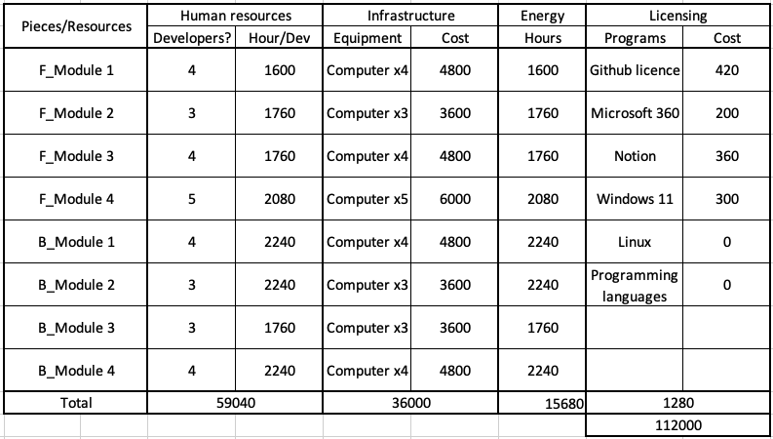
Budget
Estimated initial budget:
$112,000 USD

Slide 8
Effort
This refers to the process of estimating the amount of human effort, typically measured in person/hrs or person/days, required to complete a specific task, project allocation, and cost estimation.
Originally the project was estimated to be made in 12 months. Divided in 8 modules: 4 frontend, 4 backend. Only 6 developers needed for the task.

Slide 9
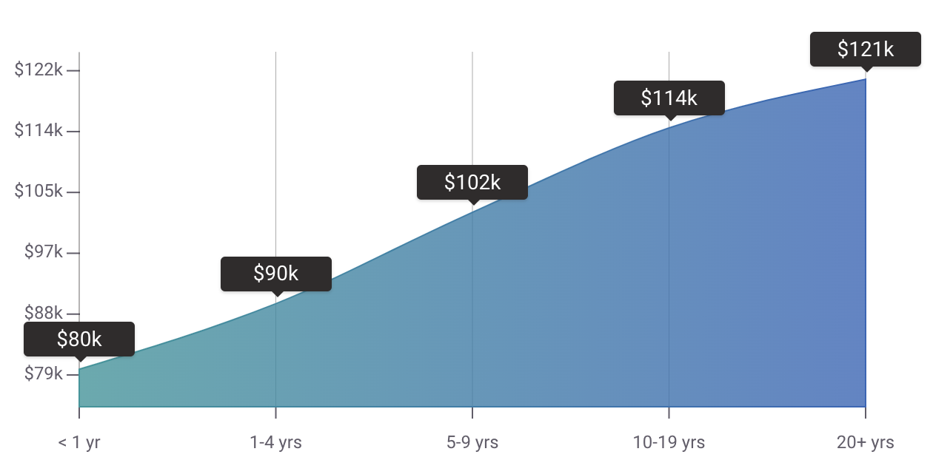
Human Resources
According to the web payscale.com the range of salary for a software developer comes from $80K to $121K USD per year ($7,000 to $12,000 USD per month).
In this project, we already need at least 6 developers for the current modules.

Slide 10
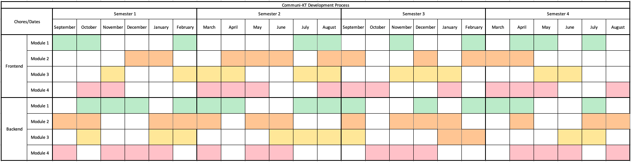
Time
The initial project schedule is estimated to be launched in 24 months, each module is expected in 3 months.

Slide 11
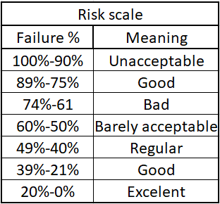
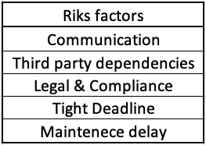
Risks
Risks factors and scale:

Slide 12
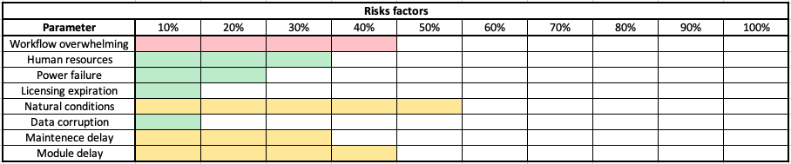
Risks
Chances in % per risk factor:

Slide 13
CR1: .
User percentage time on seen advertisements.

Slide 14
Modules affected
To begin with, all of the changes will only affect the server side of the system. By the nature of the CR 1, the modules affected require changes on its functionalities:
Data collection and data analysis, data encryption.
New terms and conditions for the users.
Advertising features. New module
Support for 3rd parties’ plugins.

Slide 15
Human Resources
As more computers aren’t needed to fulfill the task, more developers might be hired. In this aspect we got one option:
Hire more personnel: 2 developers.

Slide 16
Costs
The additional cost of the Change Request is estimated at: $30,000 USD. Which includes the additional team salaries and costs associated with adding this feature, such as:
Database for storage all the information, in the essence of the DB Management software as well as the design.
Encryption of the user’s information
Data analysis of user’s behavior.
3rd party integration for e-shops, healthcare, and services.

Slide 17
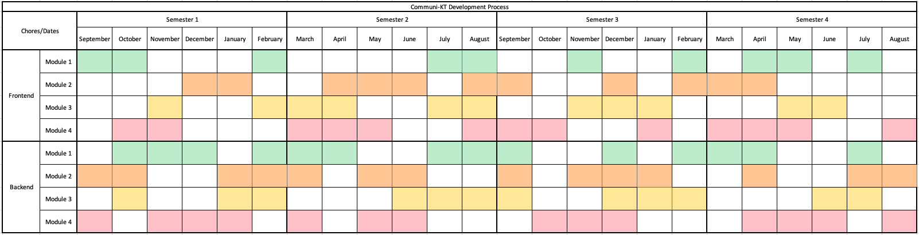

Time
Since we are planning to utilize the same time schedule and the same amount of developers, we’re only expecting to include and extra month in 3rd module.

Slide 18
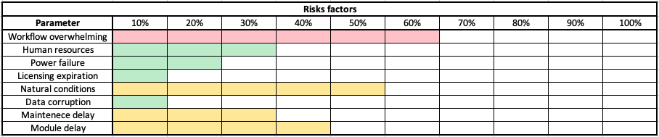
Risks
Chances in % per risk factor:

Slide 19
Effort
Throughout the development of the system, the most affected module is the Data analysis. The addition of a new module will also more work per developer. One extra month at maximum.

Slide 20
Percentage in which CR1 would affect
Time: 5%
Budget: 27%
HR: 33%
Work Effort: 48%

Slide 21
Executive summary
Reason of decline: The current CR does represent a fundamental block for the commercial features of the system.
Due to the no too large extra cost, the addition of 2 extra developers and poor potential profitability; we’ve resolved to decline the Change Request.

Slide 22
CR2: .
The type of content of the advertising attracting the attention of the social media user.

Slide 23
Modules affected
The begin with, all of the changes will only affect the server side of the system. By the nature of the CR2, the modules affected require changes on its functionalities.+:
Data analysis.
Link of corporative DB with 3rd party services.

Slide 24
Human Resources
The expansion to the development team will involve the addition of 1 new member: A backend developer.

Slide 25
Costs
The additional cost of the Change Request is estimated at: $45,000 USD. Budgets that completely covers the additional developer’s salaries and costs associated with adding this feature, such as:
Backend development.

Slide 26
Time
The project is expected to increase in 3 months of development, in order to make sure every single change is working correctly.

Slide 27
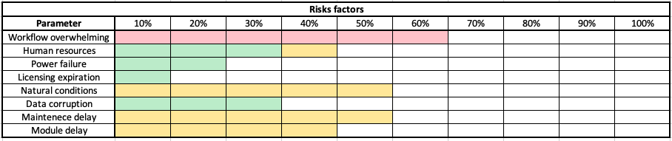




Risks
Chances in % per risk factor:

Slide 28
Effort
By the analysis of the given CR, is completely clear the most affected modules are: Data analysis, Link of DB with 3rd party services. This CR will cost $13,400 USD including the addition of one developer and 3 months of work.

Slide 29
Percentage in which CR2 would affect
Time: 12.5%
Budget: 12%
HR: 16%
Work Effort: 10%

Slide 30
Executive summary
Simple but highly beneficial for the business income in terms of more businesses and market places would be interested in investing with us.
Final decision: Accepted.

Slide 31
CR3: .
Purchases made through the platform according to female and male products, age, and sexual orientation.

Slide 32
Modules affected
To begin with, all of the changes will only affect the server side of the system. By the nature of the CR3, the modules affected require changes on its functionalities:
Database inclusion of new entities.
New terms and technical conditions for 3rd parties modules.
Digital marketing system.

Slide 33
Human Resources
The development team will be seen growing in 4 more developers: one specialist in digital marketing; 2 developers for 3rd parties support; and one more developers for data management.

Slide 34
Costs
The additional cos of the Change Request is estimated at: $65,000 USD. Budget that successfully covers the additional developer’s salaries and costs associated with adding this feature such as:
A developer responsible for all data structures, usage, storage and managing properly this indispensable resource.
Reliability assurance of business for 3rd party developers and market places.
Growth in our database model.

Slide 35
Time
The project is expected to increase in 8 more months of development, if order to make sure every single requirement is working correctly.

Slide 36
Risks
Chances in % per risk factor:

Slide 37
Effort
During the analysis of given CR, is completely clear that the most affected modules are: Databases, Data analysis and Digital marketing. The CR will cost $45,000 USD including the addition of 3 more developers and 5 more months of development.

Slide 38
Percentage in which CR1 would affect
Time: 34%
Budget: 58%
HR: 67%
Work Effort: 40%

Slide 39
Executive summary
This idea is great and the income could be highly increased by the good implementation of it. Though, it sounds amazing in paper, the reality is that this CR is expensive in finance . Costing almost half of the current budget.
Final decision: Declined.

Slide 40
CR4: .
The system should report statistics of users regarding time spent, log-in hours, and activities performed. The reports must be encrypted, and the time span of the report must be flexible.

Slide 41
Modules affected
To begin with, all of the changes will only affect the server side of the system. By the nature of the CR 1, the modules affected require changes on its functionalities:
Data collection and data analysis, data encryption.
New terms and conditions for the users.
Advertising features. New module
Support for 3rd parties’ plugins.

Slide 42
Human Resources
As more computers aren’t needed to fulfill the task, more developers might be hired. In this aspect we got one option:
Hire more personnel: 2 developers.

Slide 43
Costs
The additional cost of the Change Request is estimated at: $30,000 USD. Which includes the additional team salaries and costs associated with adding this feature, such as:
Database for storage all the information, in the essence of the DB Management software as well as the design.
Encryption of the user’s information
Data analysis of user’s behavior.
3rd party integration for e-shops, healthcare, and services.

Slide 44

Time
Since we are planning to utilize the same time schedule and the same amount of developers, we’re only expecting to include and extra month in 3rd module.

Slide 45
Risks
Chances in % per risk factor:

Slide 46
Effort
Throughout the development of the system, the most affected module is the Data analysis. The addition of a new module will also more work per developer. One extra month at maximum.

Slide 47
Percentage in which CR1 would affect
Time: 5%
Budget: 27%
HR: 33%
Work Effort: 48%

Slide 48
Executive summary
Reason of decline: The current CR does represent a fundamental block for the commercial features of the system.
Due to the no too large extra cost, the addition of 2 extra developers and poor potential profitability; we’ve resolved to decline the Change Request.

Slide 49
Executive summary
Social Media App Based On Metaverse.

Slide 50
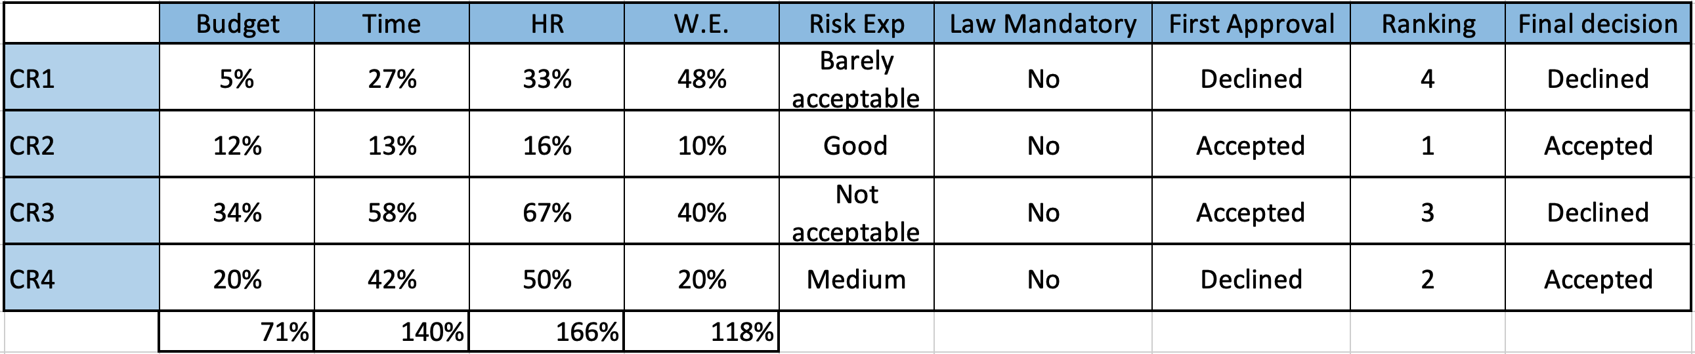

Slide 51
Questions & answers
Thank you!

